Slide 1
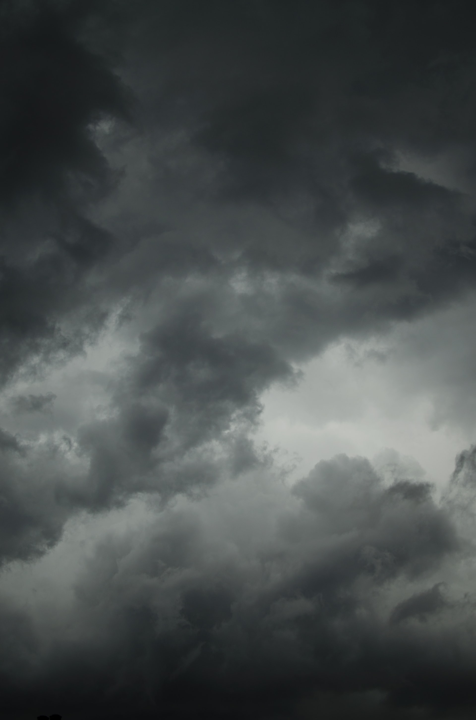
A TRAVEL GUIDE FOR POTTERHEADS
PRESENTED BY: SURAMYA SURESH BABU

Slide 2
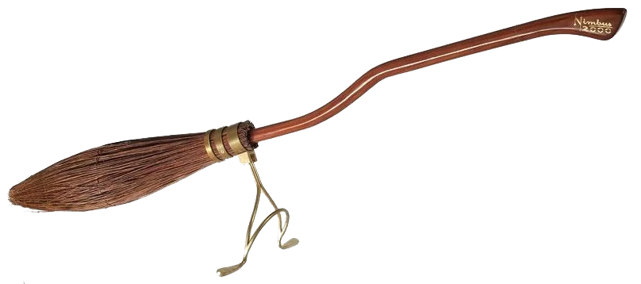
CONTENTS
Background
Inspiration
Description of the Spatial Data
Demonstration
Conclusion

Slide 3
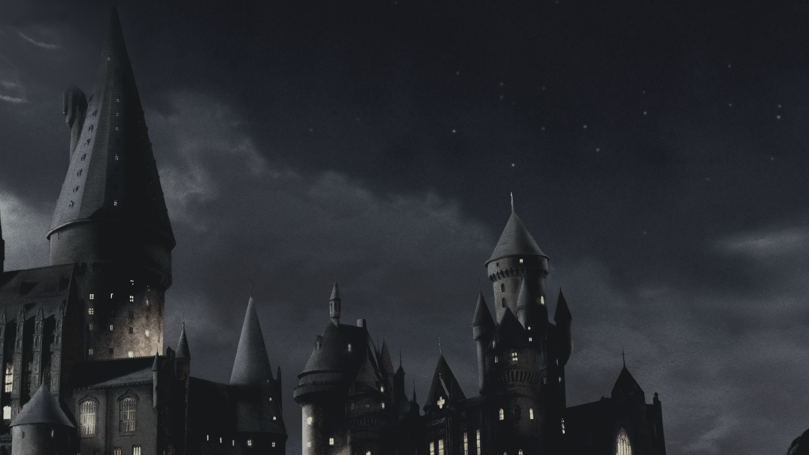
BACKGROUND
Harry Potter is a series of eight fantasy novels written by J. K. Rowling.
The novels chronicle the lives of a young wizard, Harry Potter, and his friends Hermione Granger and Ron Weasley, all of whom are students at Hogwarts School of Witchcraft and Wizardry. The main story arc concerns Harry's struggle against Lord Voldemort, a dark wizard who intends to become immortal, overthrow the wizard governing body known as the Ministry of Magic.

Slide 4
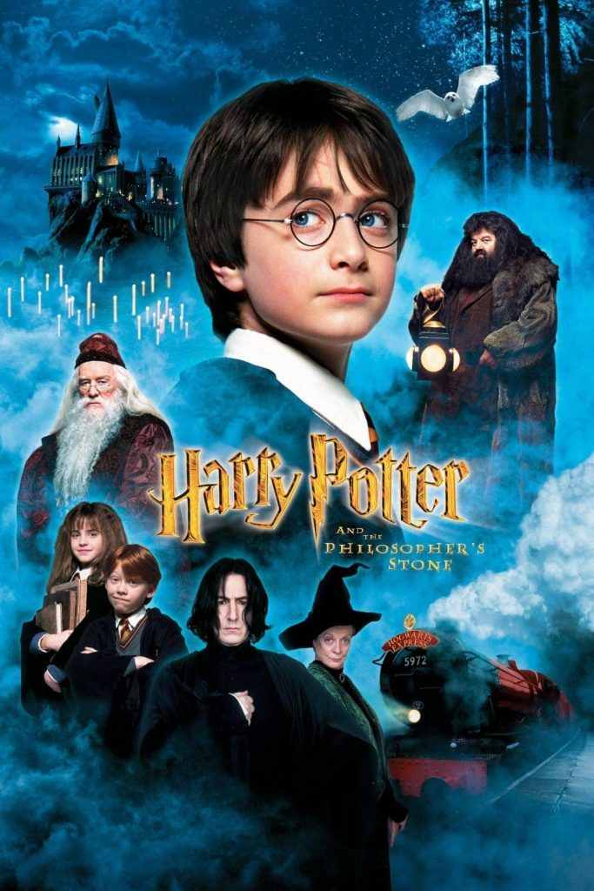
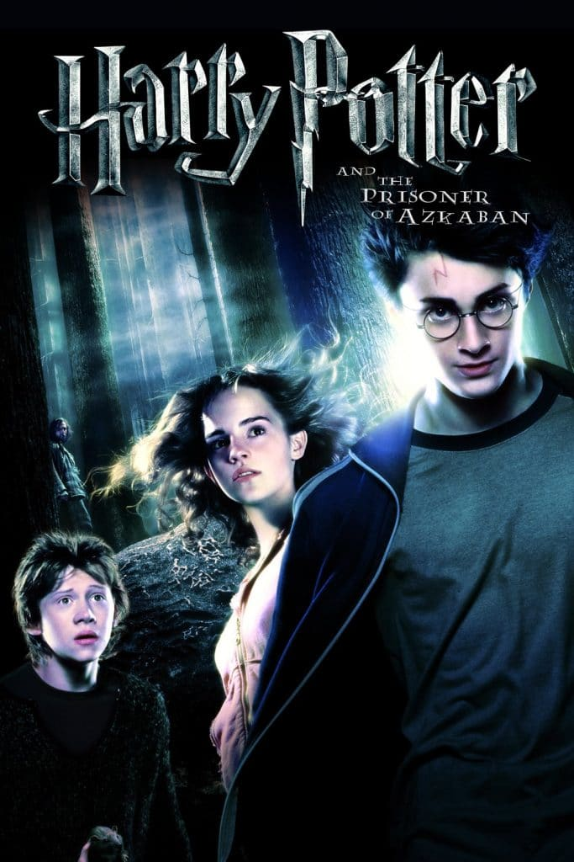

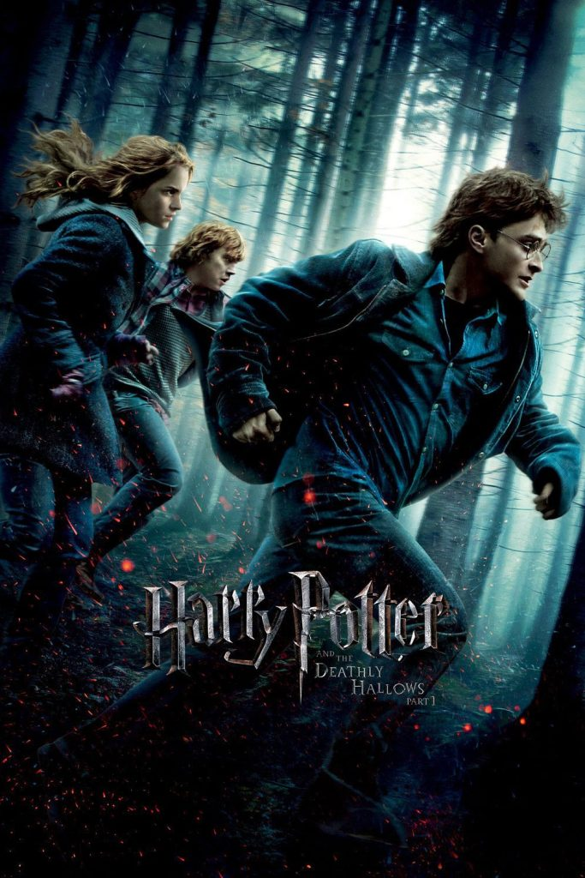
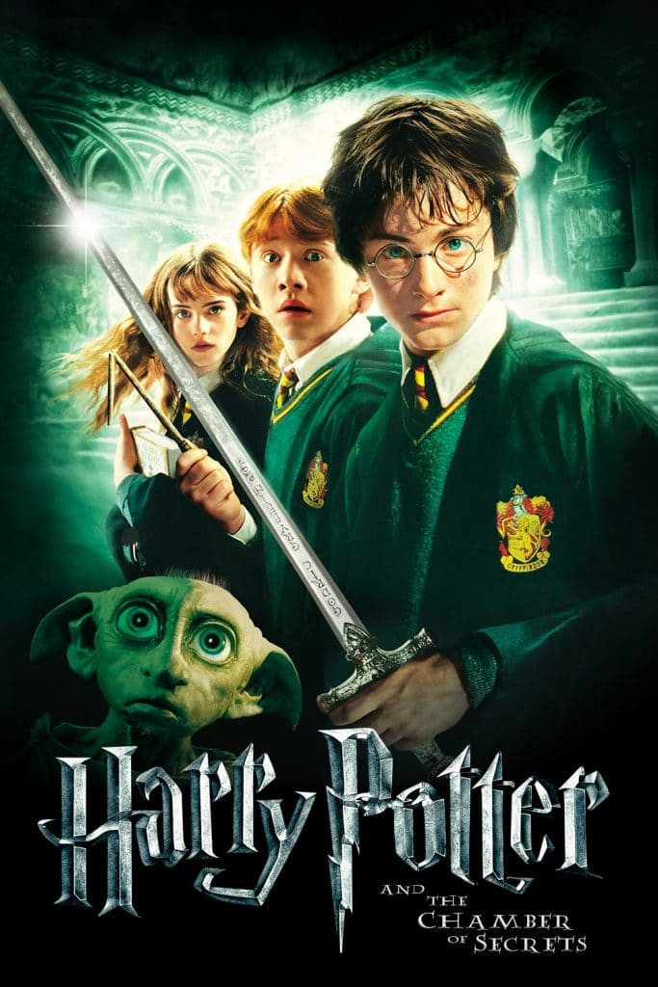
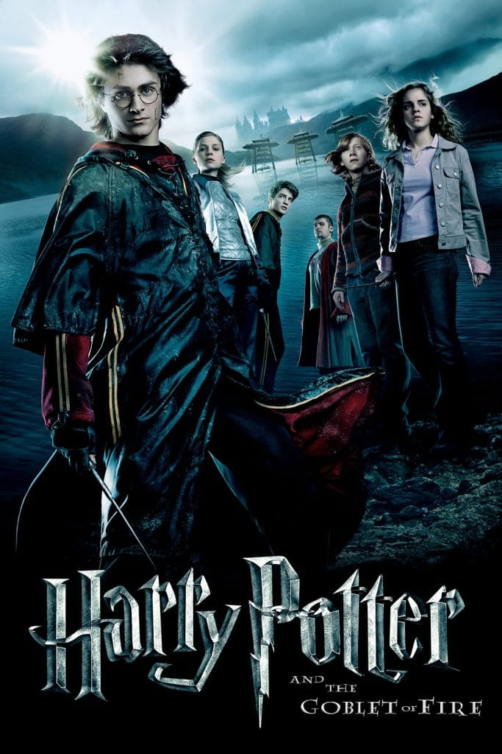
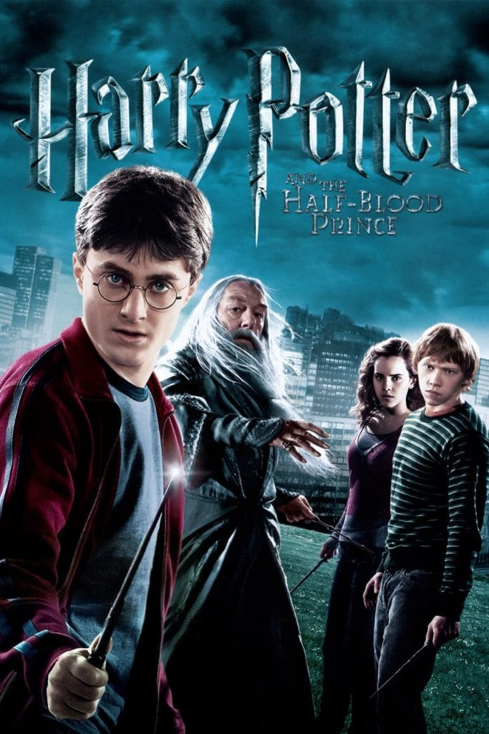
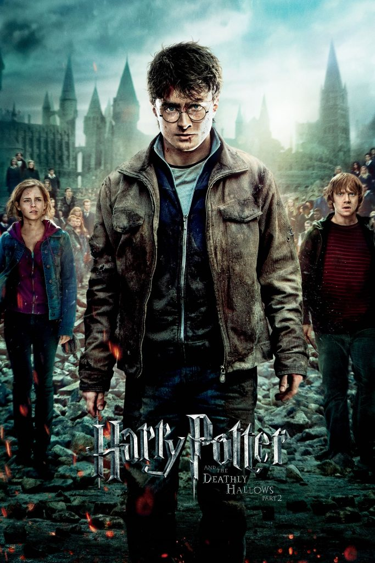
MOVIES
Harry Potter and the
Prisoner of Azkaban
Order
of
Phoenix
Deathly Hallows Part 1
Sorcerer’s Stone
Goblet
of
Fire
Deathly Hallows Part 2
Chamber of Secrets
Half Blood Prince

Slide 5
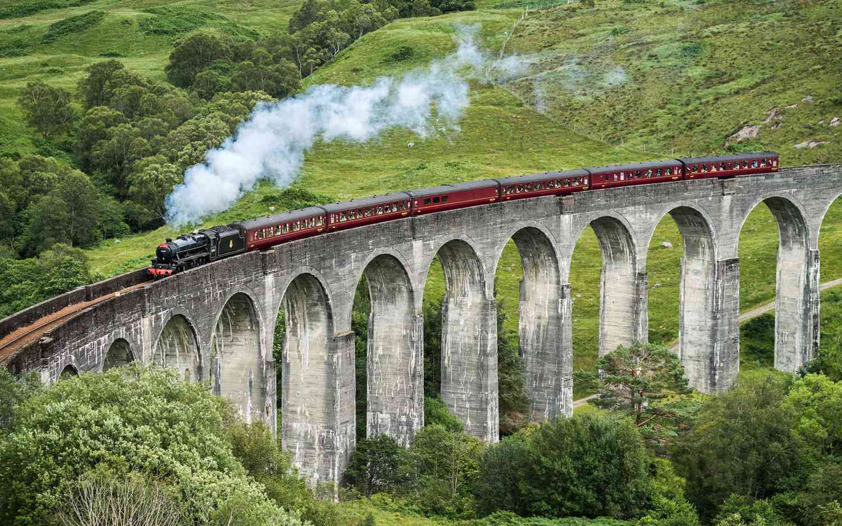
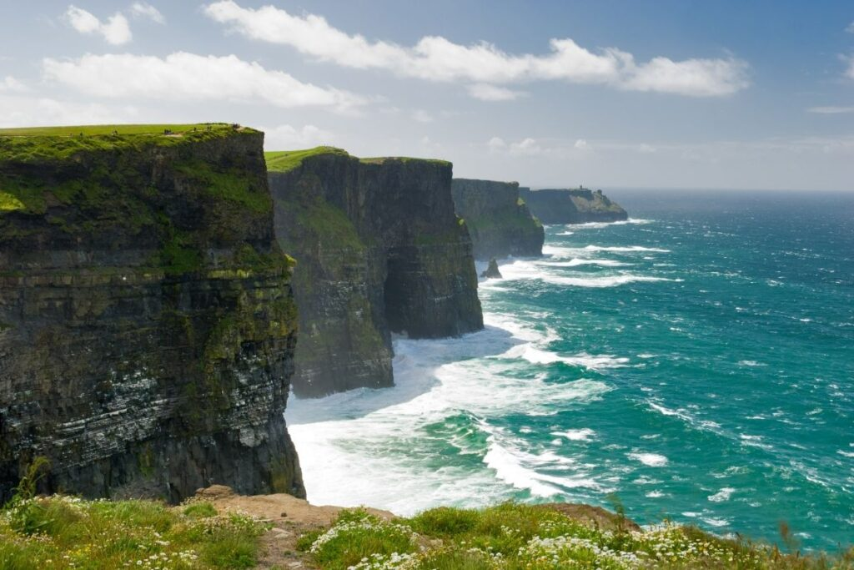
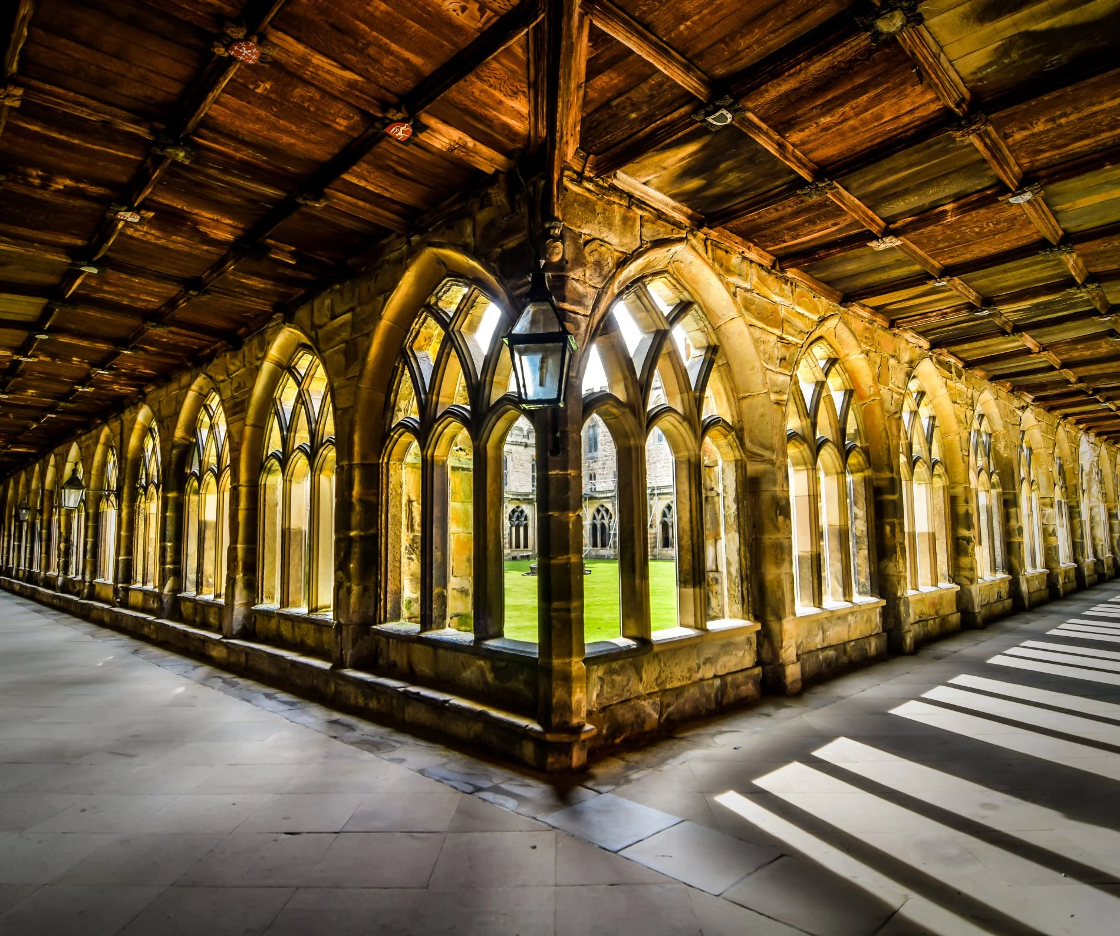
INSPIRATION
Thanks to various HP-fan site, travelers have access to almost all the locations mentioned in the books or shown in the movies. These blogs show that we can at least visit the spots that inspired those fictional establishments. From majestic castles and train rides over rolling Scottish hillsides to historic hotels and secret wizarding shops, Muggles traveling to these Harry Potter filming locations will be entirely convinced that magic truly does exist.
Glenfinnan Viaduct, Scotland Cliffs of Moher, Ireland Durham Cathedral, London

Slide 6
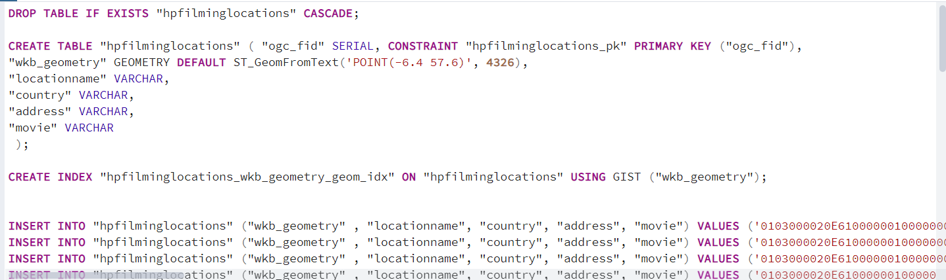
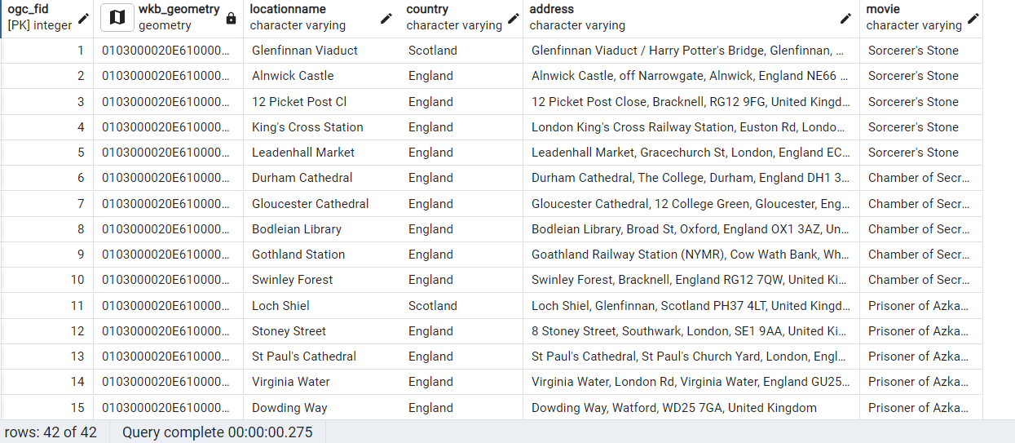
DESCRIPTION OF SPATIAL DATA
HPFilmingLocations Table - wkb_geometry column -> Polygons
Table Creation
Sample Table

Slide 7
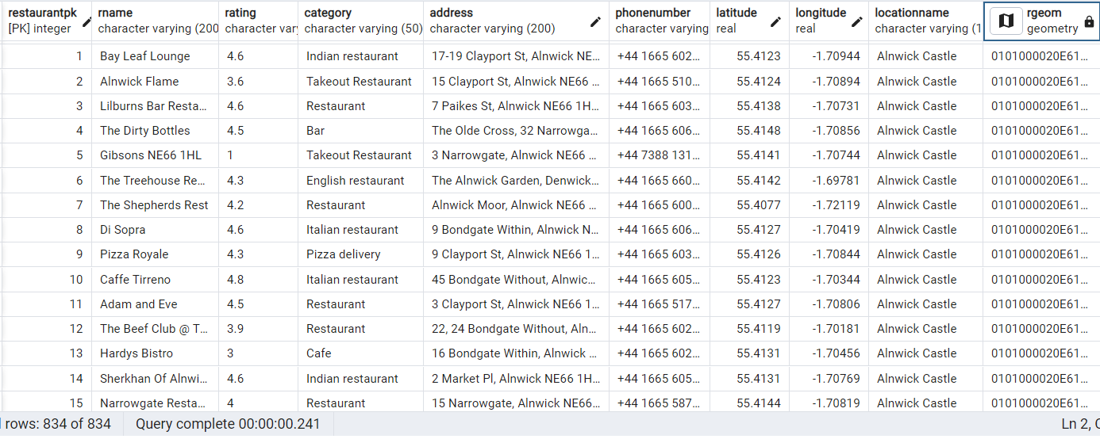
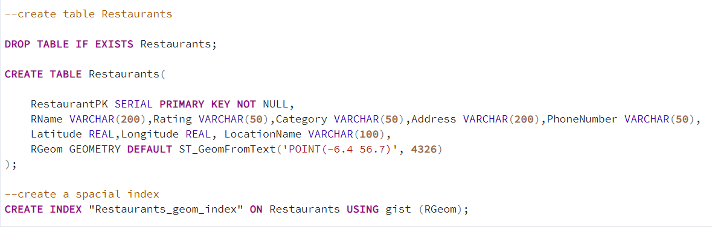
2) Restaurants Table – RGeom column -> Points
Table Creation
Sample Table

Slide 8
DEMONSTRATION

Slide 9
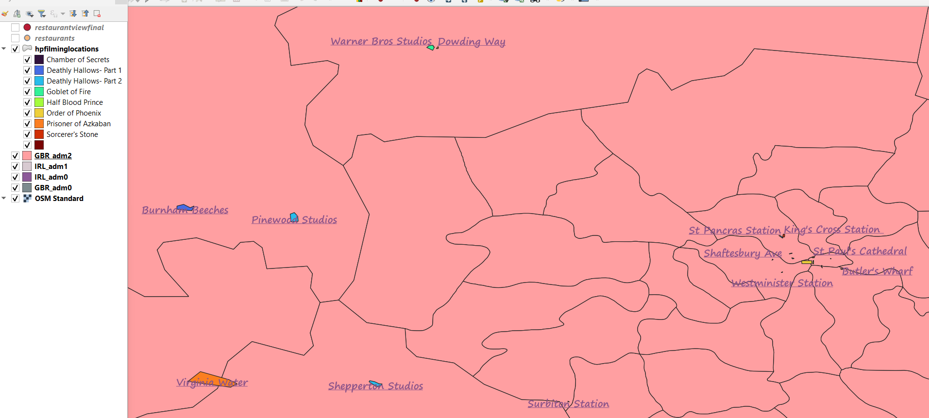
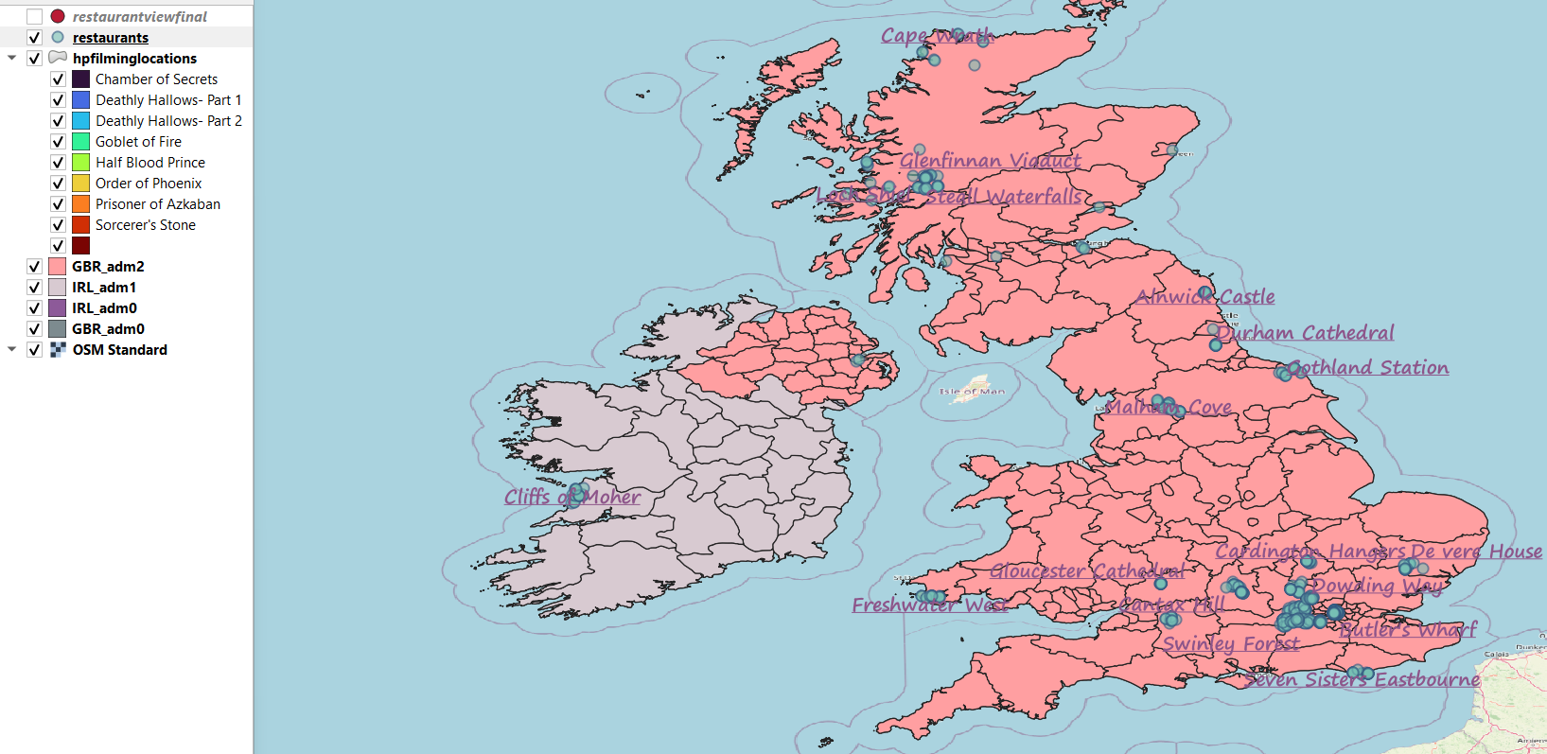
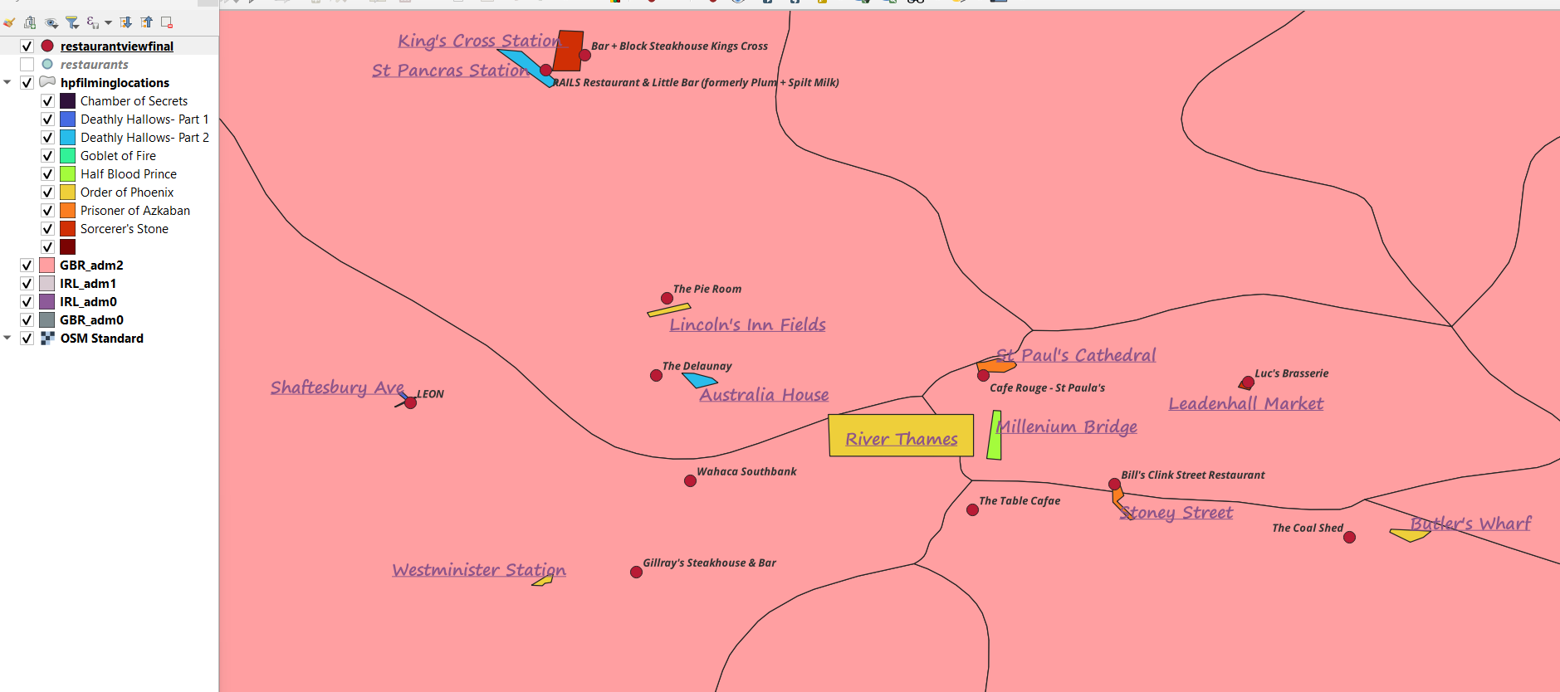
CONCLUSION
Restaurant near the Location in QGIS
HPFilmingLocations in QGIS
Restaurants in QGIS

Slide 10
THANK YOU

